Slide 1

Predicting Sales by User Features
Rahul Pahuja Capstone 1

Slide 2

What factors affect the sales?
The Problem
A retail company “ABC Private Limited” wants to understand the customer purchase behaviour (specifically, purchase amount) against various products of different categories.

Slide 3
What factors affect the sales?
City prices
Gender
Age
Occupation

Slide 4
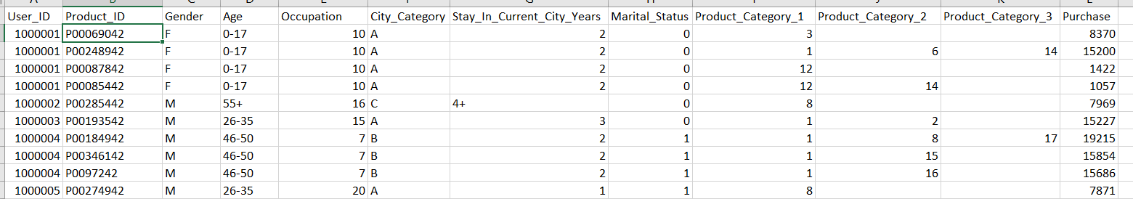
Data Information
550068 observations
12 features
Mix of categorical and continuous features

Slide 5
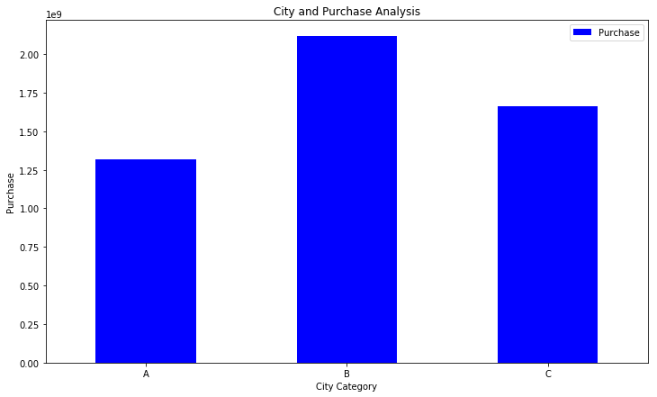
Features and their relationships
City B has the most transactions and City A has the least number of transactions among the 3. It has more purchase on an average

Slide 6
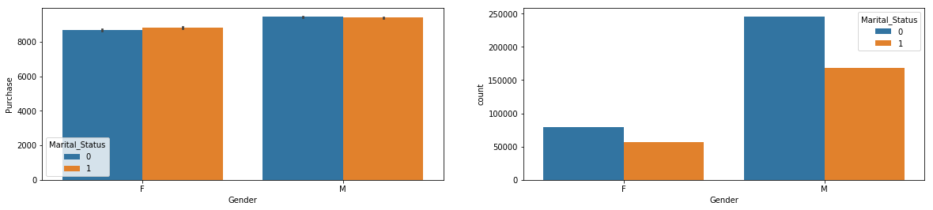
Here we can see the buying patterns are not that Gender has more effect on the amount of purchase than marital status. As we can see men outnumber women a lot. However the average shows that men are more likely to spend more money than women.

Slide 7
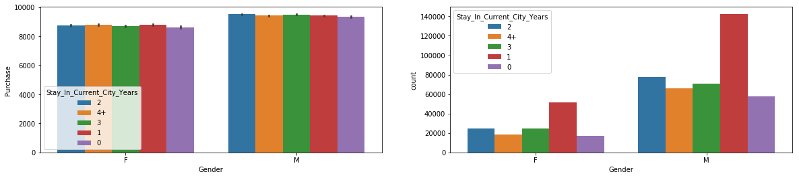
In case of average purchase it does not matter how much time someone has spent in a respective city. However, the men staying in the 3 cities for 1 year outnumber everyone in terms of transactions made.

Slide 8
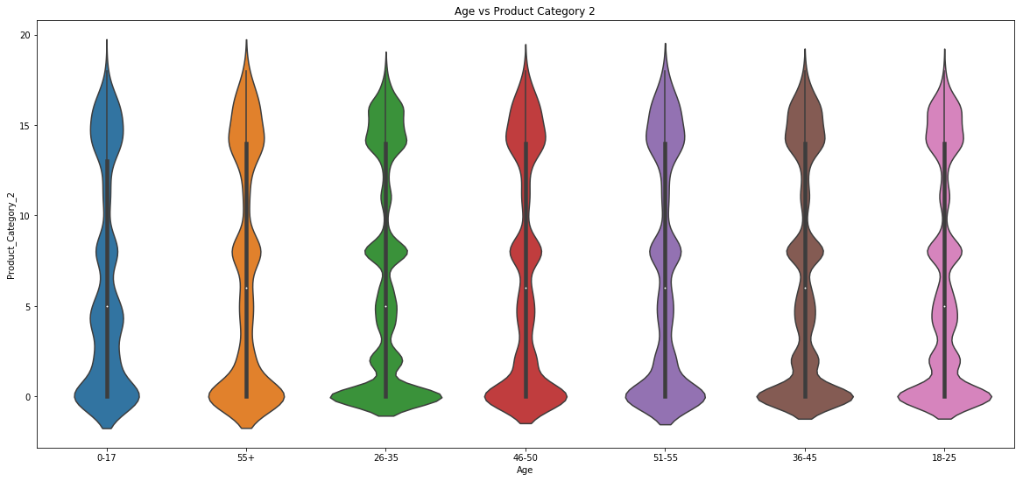
Most people have either bought large quantities. It could be that the sale has offered some gift packs or large batches.

Slide 9
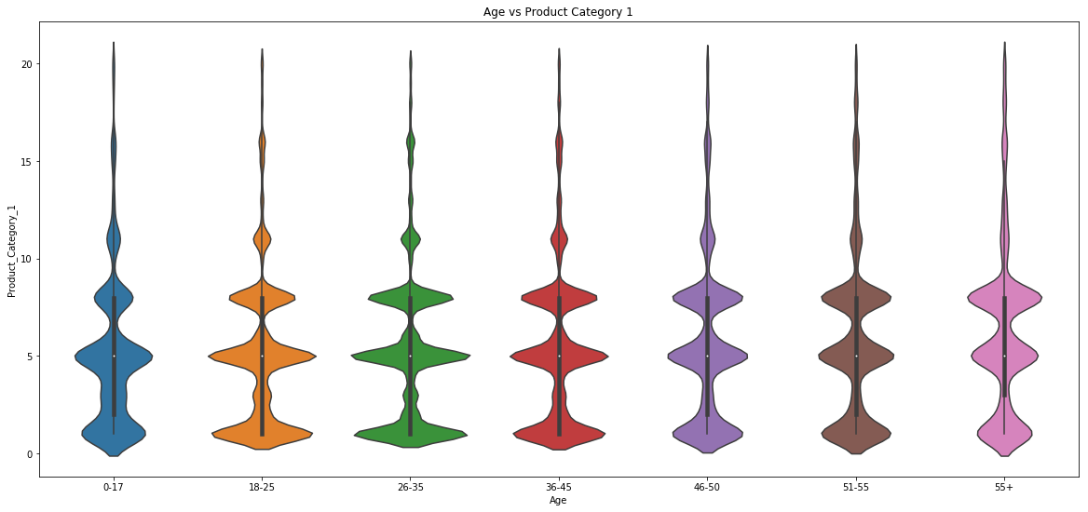
Most people have either bought in large quantities. It could be that the sale has offered some gift packs or large batches. It could also be an FMCG

Slide 10
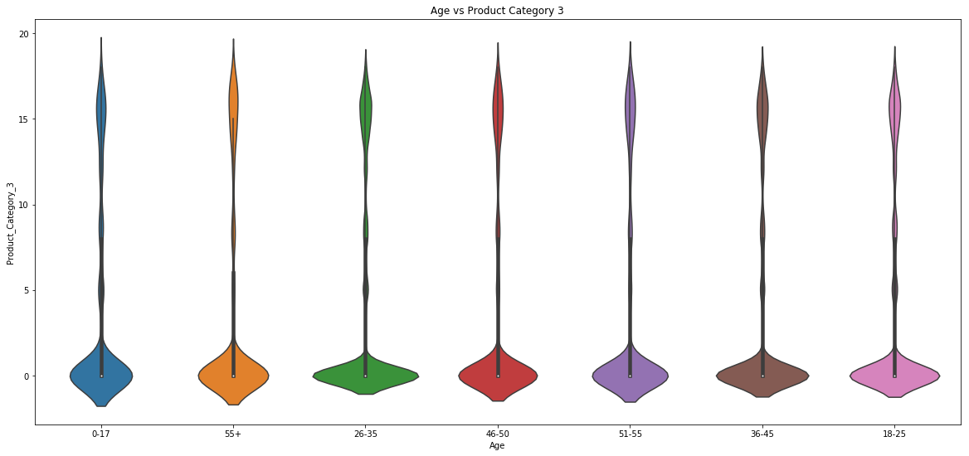
This category is either bought in very large amounts or not bought. Majority haven’t bought it.

Slide 11
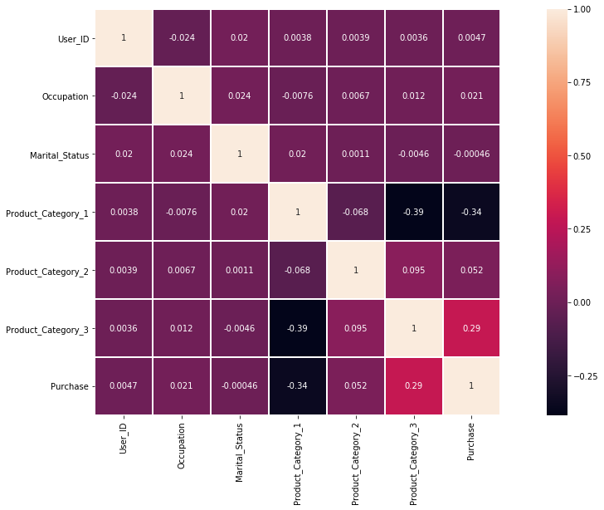

Slide 12
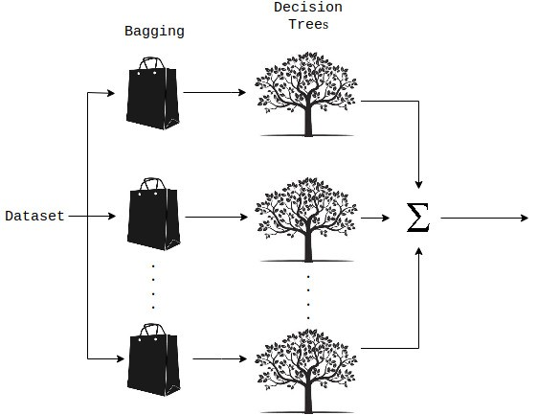
Modelling
Steps
Label Encoding is used because of ordinal nature of features.
Standard Scaler is used for scaling.
Random Forest Regressor is applied
Cross validation was also performed

Slide 13
Conclusion
Out of all models used Random Forest Gave the lowest RMSE of around 2330.
All the features were used.
With more ideas, the model can be improved in the future.

